Slide 1
CS 6220 - Covid 19
world wide visualizations and predictions
Aakanksha Duggal, Harshal Savla and Priyanka Debnath

Slide 2
Introduction

Slide 3
Insights
Data
predictions
Visualization

Slide 4

CoronaVirus
(COVID-19)
Insights
Data
predictions
Visualization
Started from China, but has rapidly spread ever since then it has been multiplying rapidly with space and time
220 COuntries, with 1,979,477 patients
Notes:
Late 2019 witnessed the birth of the current pandemic, CoronaVirus (COVID-19). It started from China, but has rapidly spread ever since then it has been multiplying rapidly with space and time. Almost 220 countries have been affected and don't seem to stop anytime soon. By the looks of it, it might look like a medical problem, but as a Data Scientist, what is the best that can be done? Overcoming this pandemic is the need of the hour, for which important decisions need to be made after understanding the underlying data. The aim of this project is to provide some insights, visualizations and predictions that can allow the government to take appropriate measures in dealing with this situation. The results show the sequential increase in infected numbers of people and deaths. However, the expectation is to find a way to flatten the curve.

Slide 5
Dataset reference
https://www.kaggle.com/sudalairajkumar/novel-corona-virus-2019-dataset

Slide 6
visualizations

Slide 7
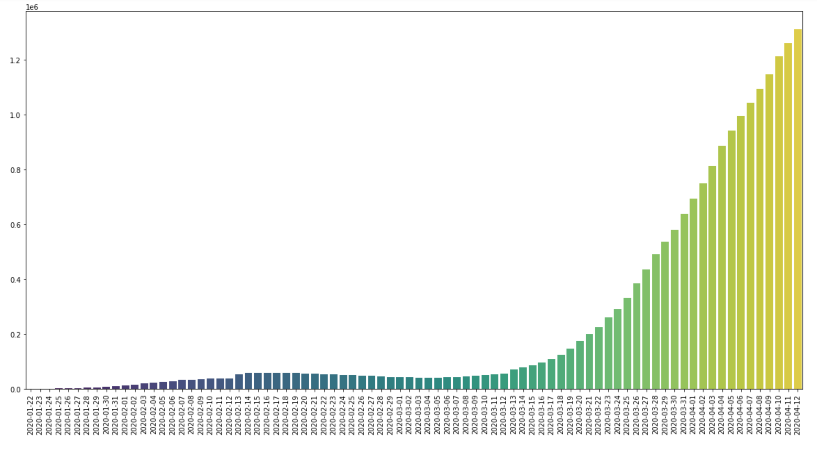
Active Cases over Date
Stating from China in November 2019.
The spread of the disease however has not been limited to China.
With major negligence and ignorance, this disease has reached about 220 countries.

Slide 8
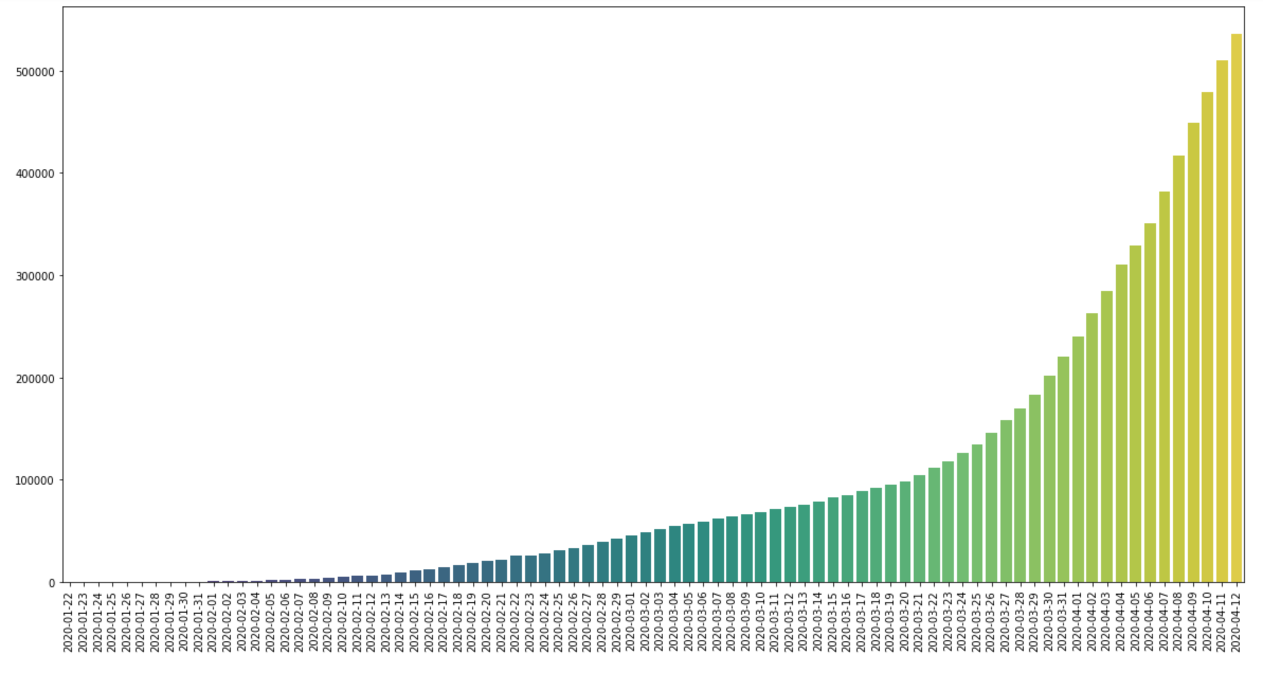
Closed Cases over Date
However, on a positive note, there has been a significant increase in closed cases.

Slide 9
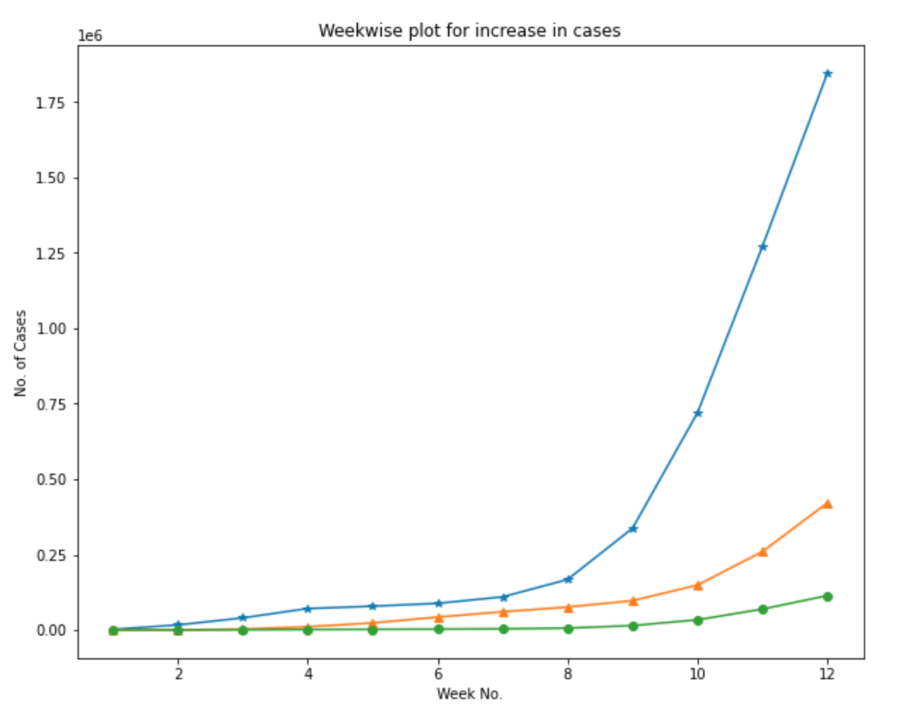
Week wise Analysis - Increase in Cases
Confirmed cases increase rapidly after Week 5.
Increase in Recovered cases is also visible after Week 6.
Deaths have seen a reasonable increase after Week 10.

Slide 10
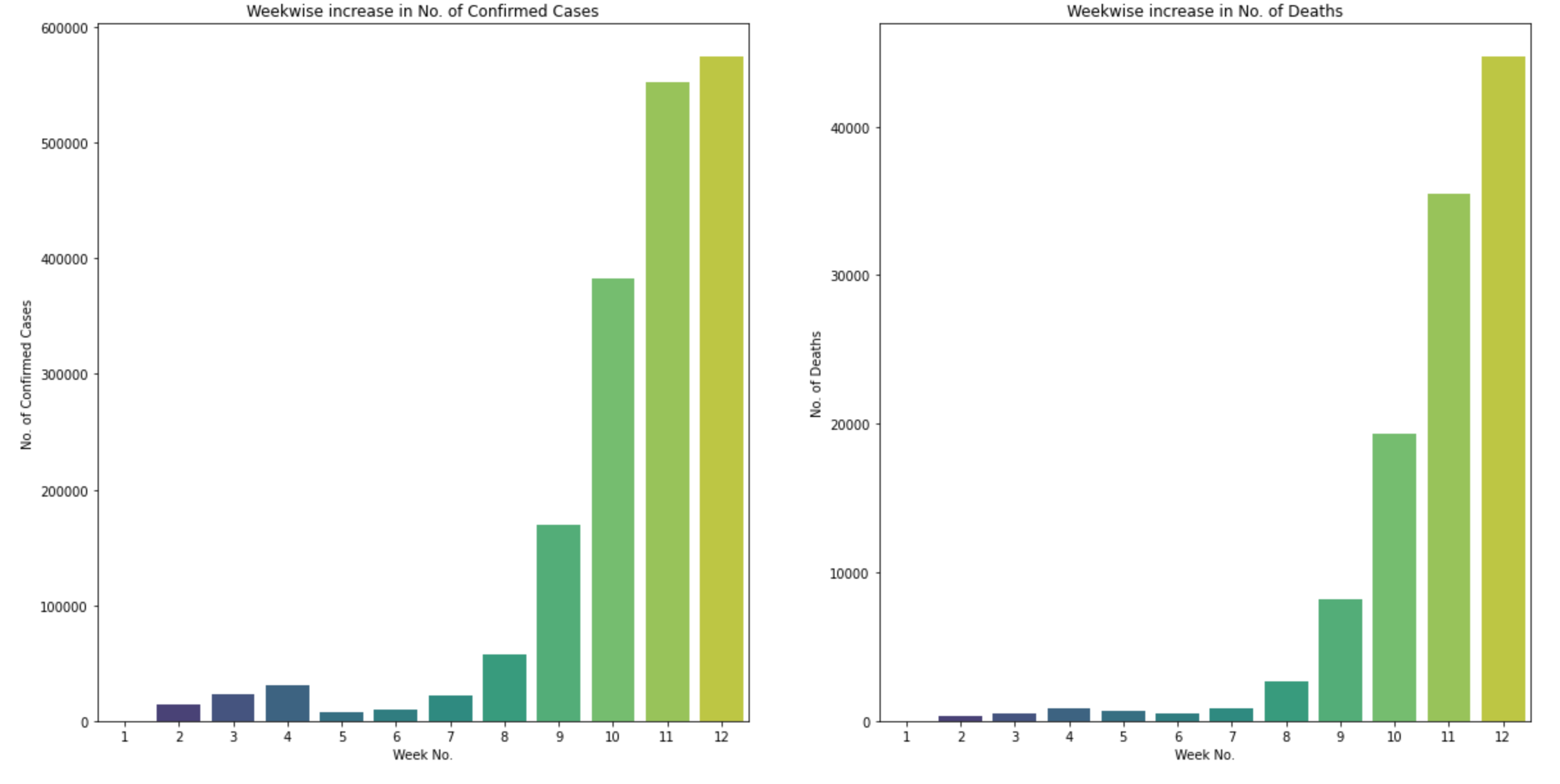
Week wise Analysis - confirmed cases vs deaths
Exponential increase in number of confirmed cases and deaths is observed.
For Confirmed cases the increase is seen from the week 7.
For deaths the increase is seen from week 8.
Notes:
Hand over to Priyanka

Slide 11
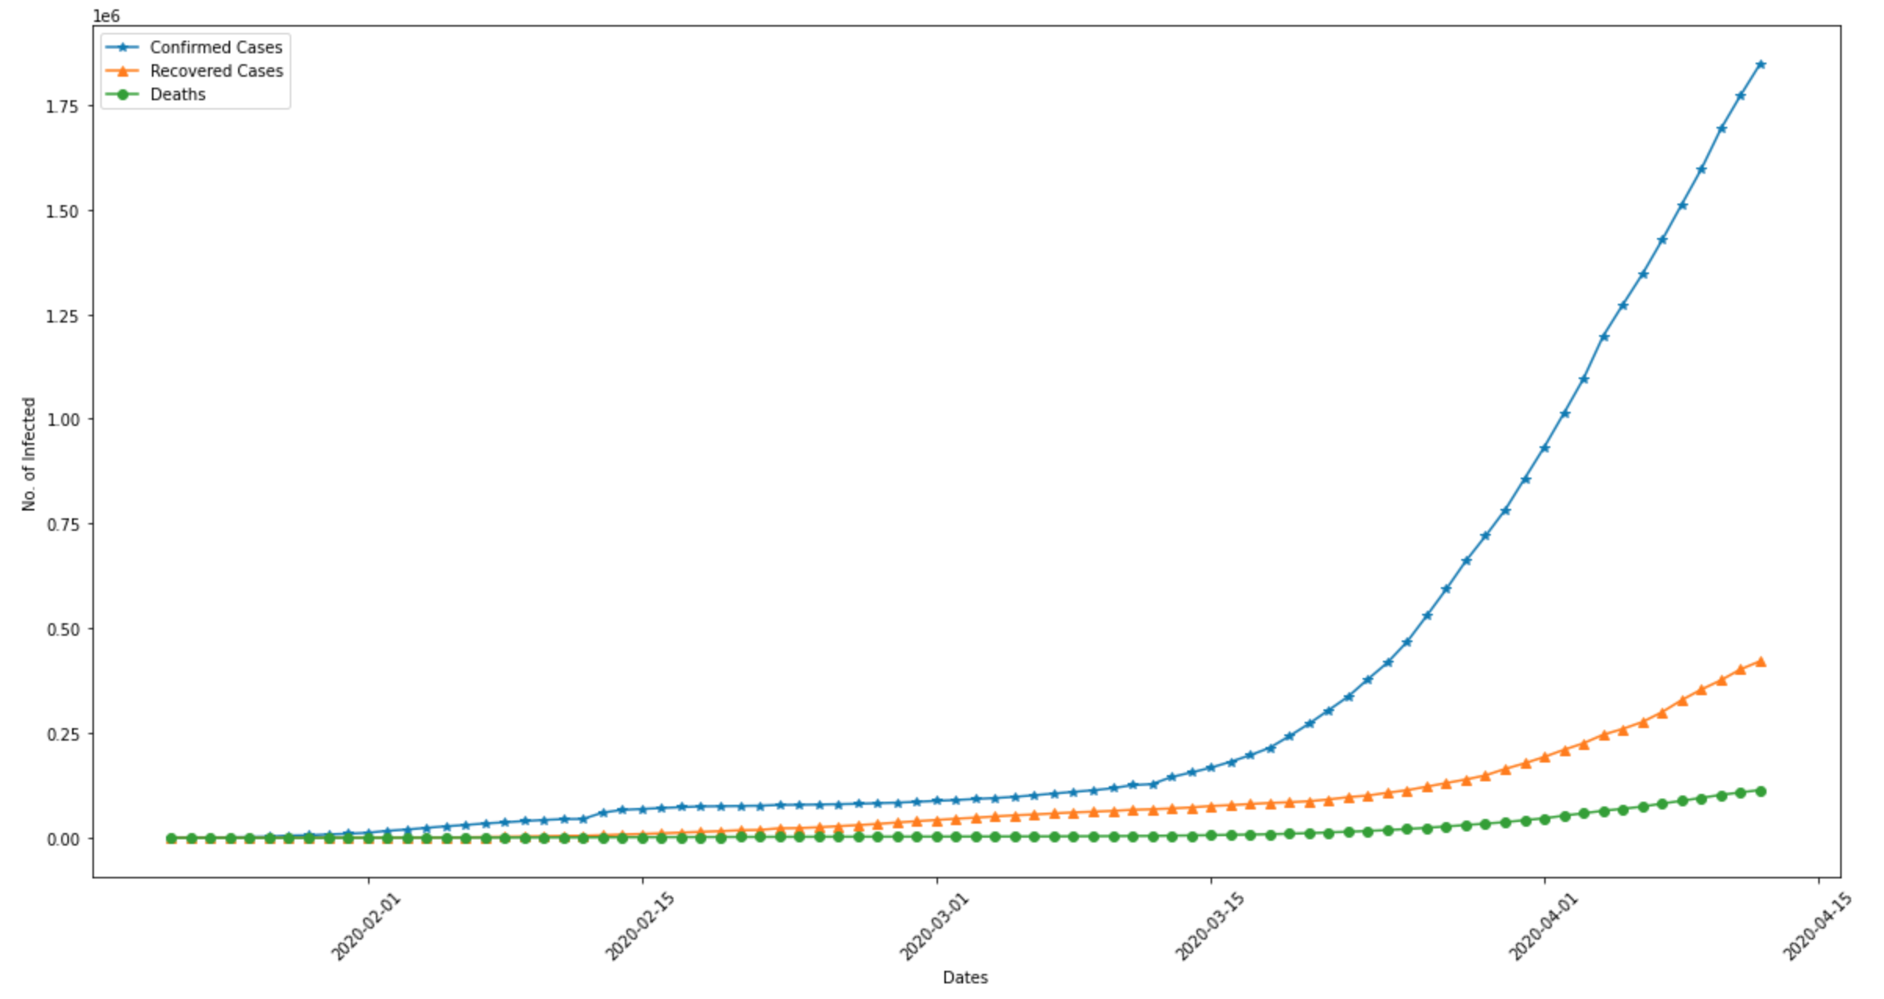
Growth rate of Confirmed, Recovered and Death Cases
Confirmed Cases all over the world increase rapidly after Mid March
Growth Rate of Recovered Cases also take a hike end of March
Deaths take a relatively less steeper curve towards the beginning of April

Slide 12
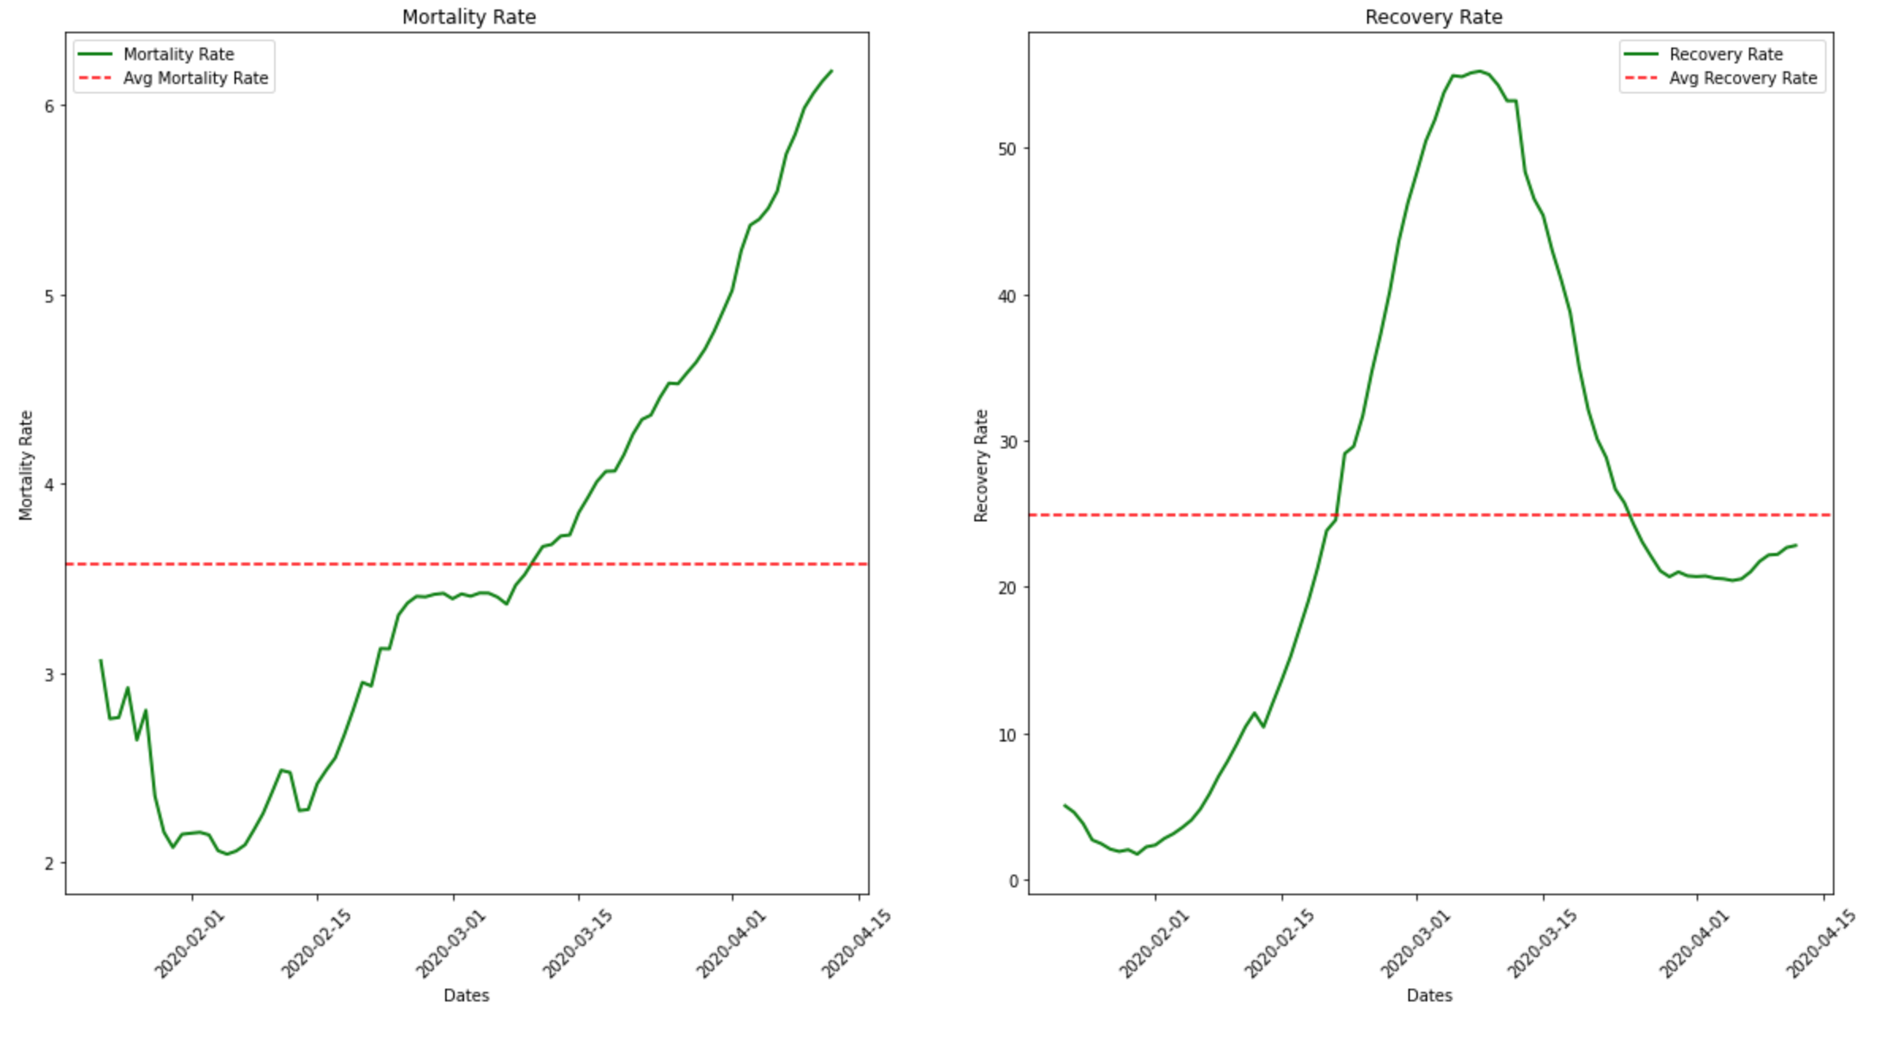
Mortality and Recovery Rate
Mortality rates rise beginning of April
Recovery rate looks like a bell curve with its peak around early March

Slide 13
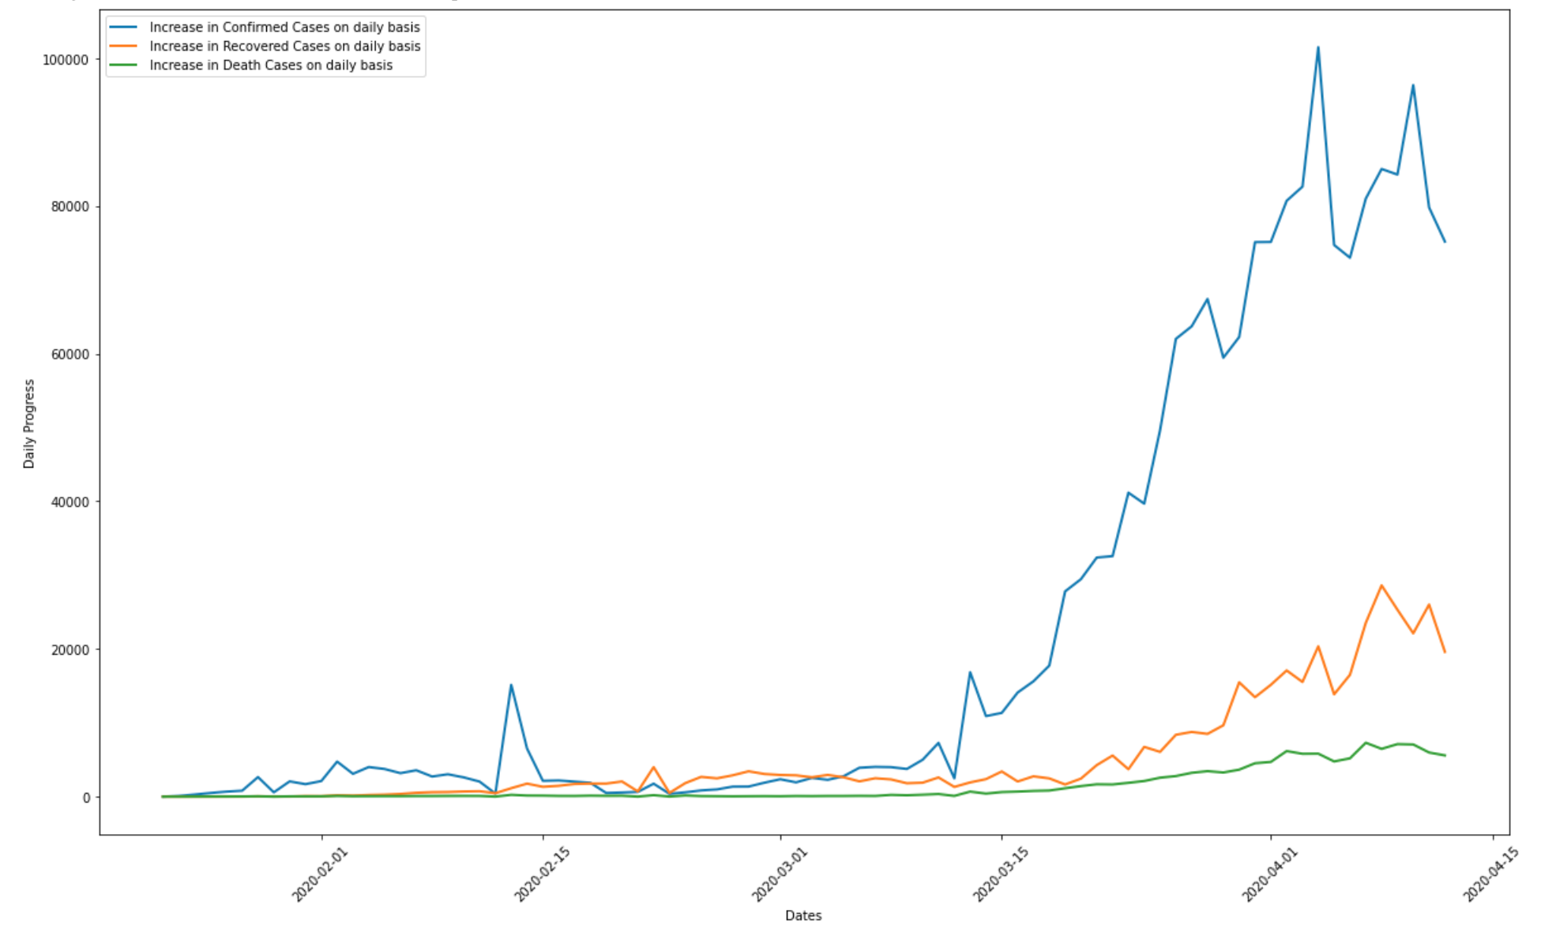
Daily increase in Confirmed, Recovered and Death Cases
Daily increase in Confirmed Cases is more erratic and intense than daily increase in Recovered cases, which says how serious this pandemic is
Death cases seems to have a comparatively more stable curve

Slide 14
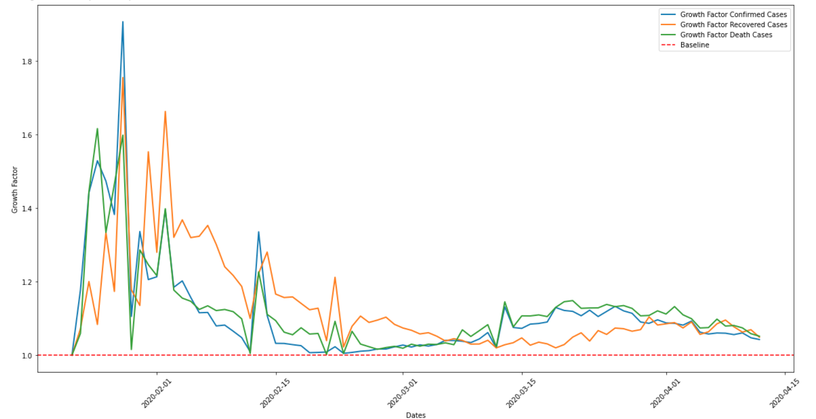
Growth Factor for Confirmed, Recovered and Death Cases
Growth Factor for all the different kind of Cases were pretty high and unpredictable around the beginning of Feb which is when this spread had started to take its shape towards a global pandemic
It has since stabilized for the past 2 months

Slide 15
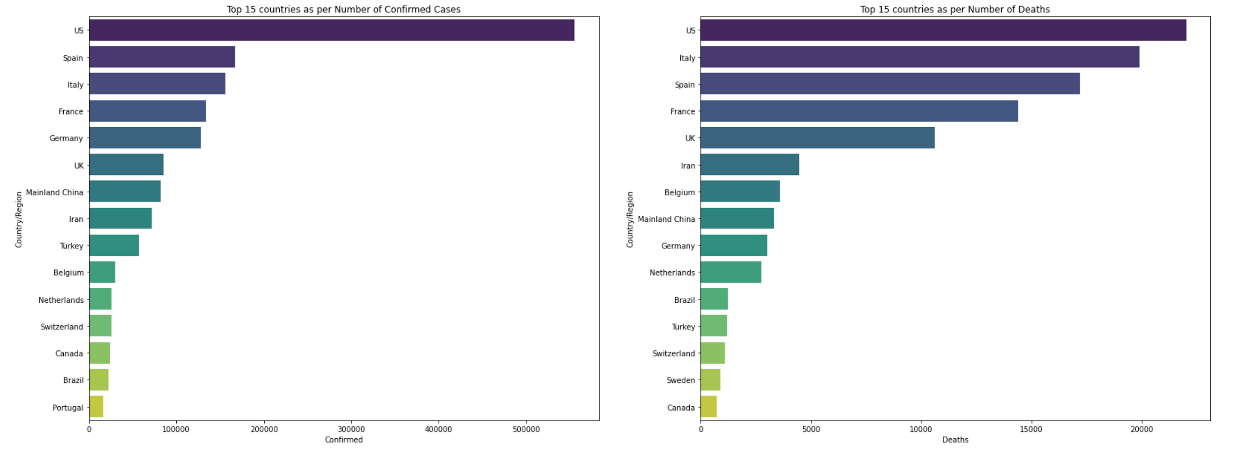
Countrywide Analysis
US infections are by far the worst, as we see both the highest number of confirmed cases vs the deaths
Fewer number of deaths compared to the number of confirmed cases, when compared to other countries vs the US

Slide 16
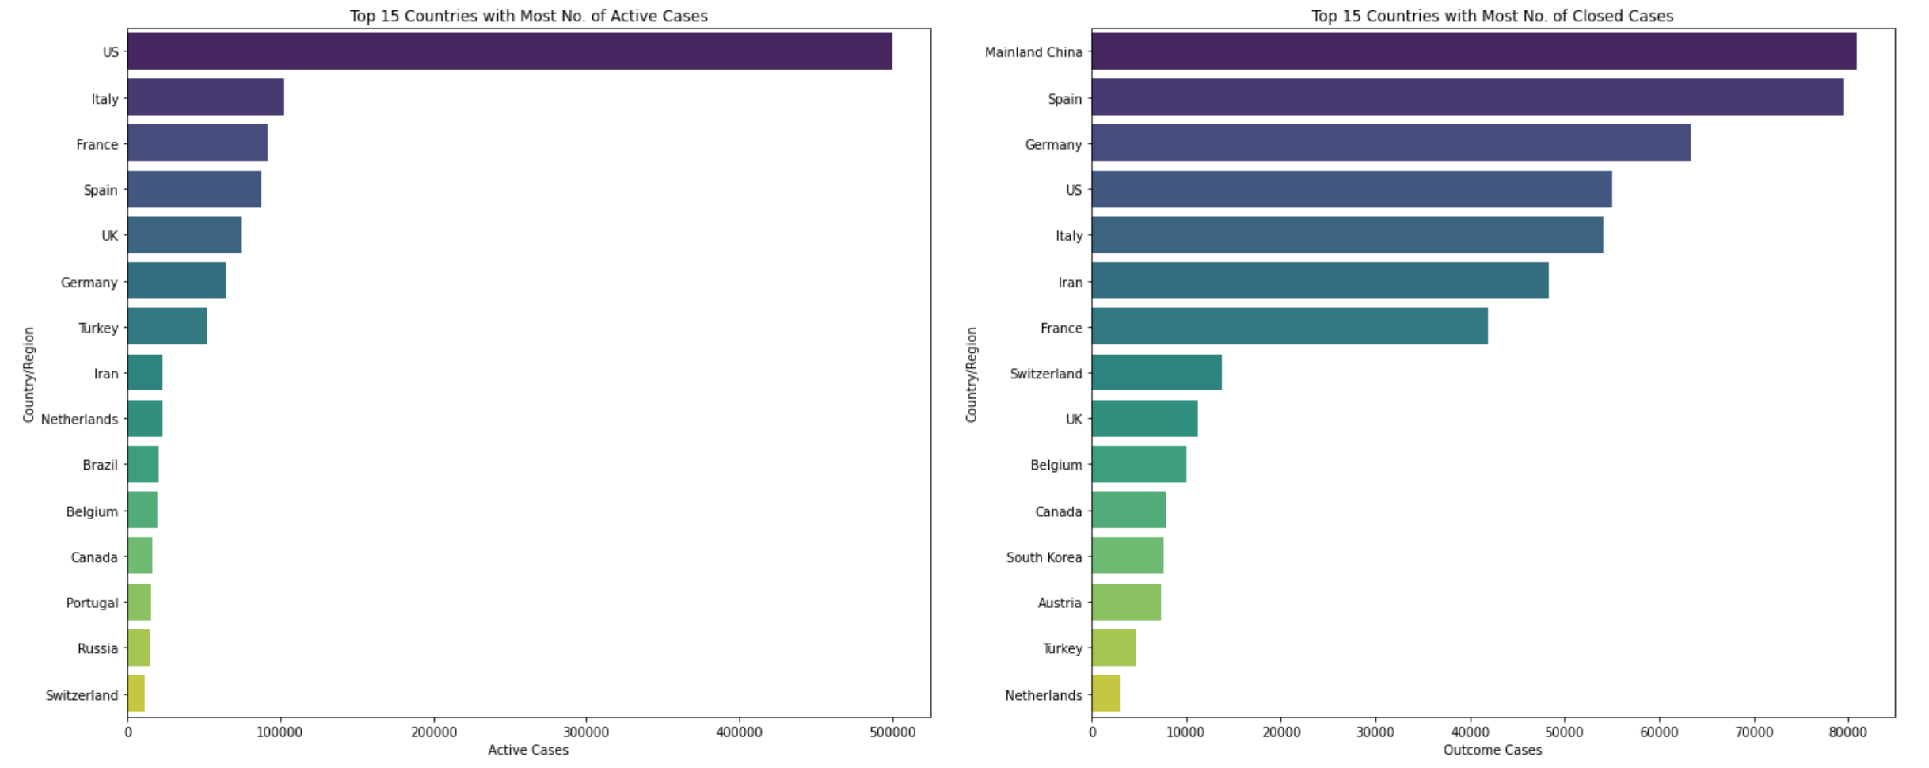
15 Countries - Most Active and Closed Cases
Countries where community spread has occurred are seeing spikes in the number of cases.
Whereas, countries like China where the spread has declined the number of closed cases has increased.

Slide 17
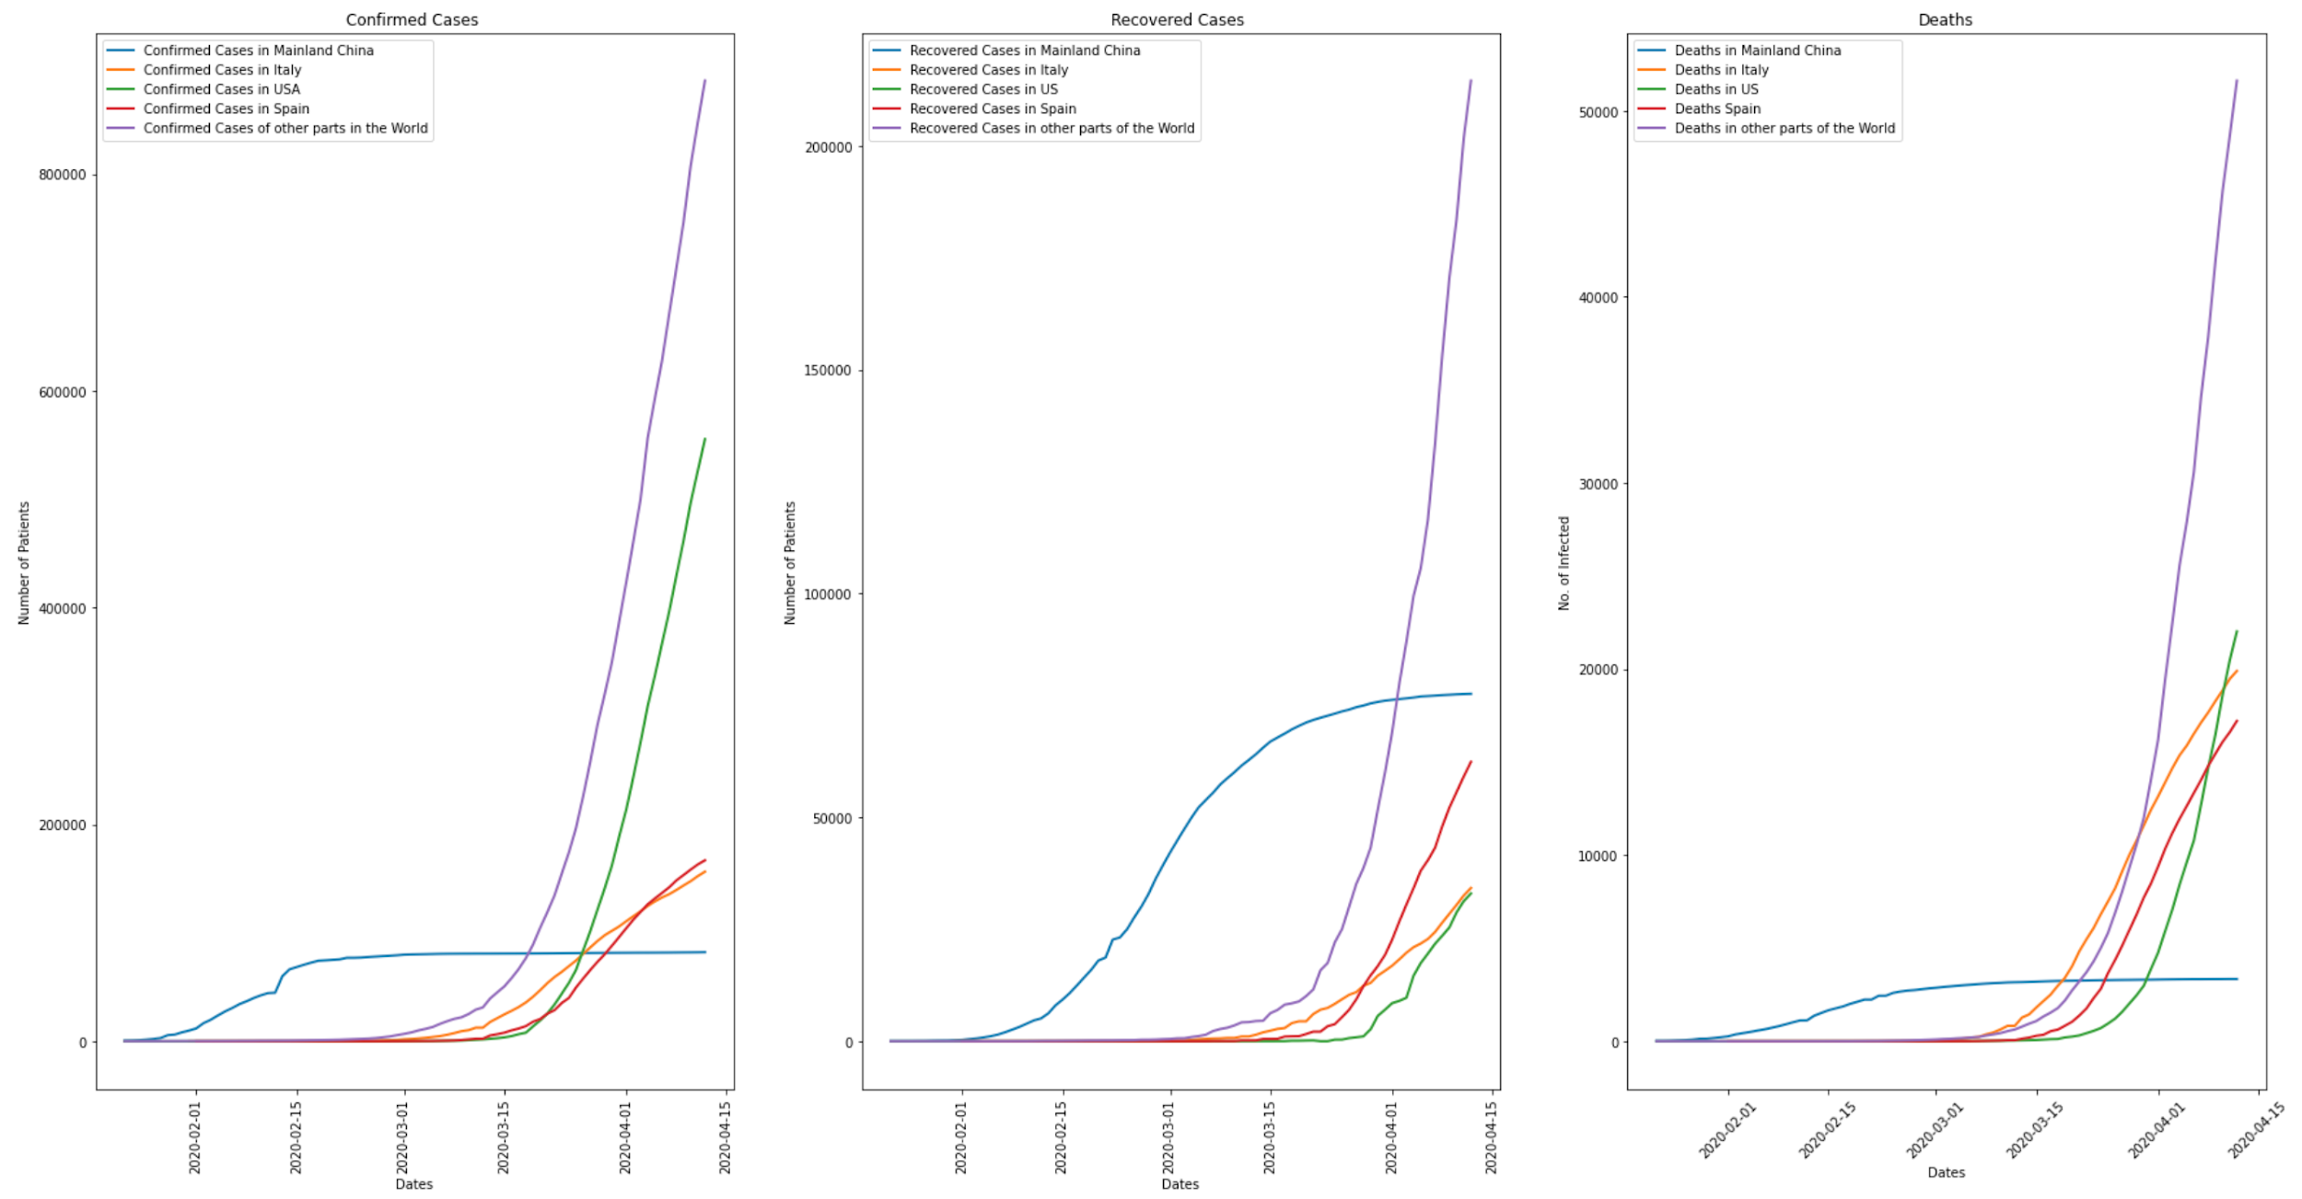
comparison - China, Italy, US and Rest of the world
We can see that China has managed to flatten the curve, however, the rest of the world is experiencing a spike in the total number of cases and number of deaths.

Slide 18
Predictions
Using machine learning models

Slide 19
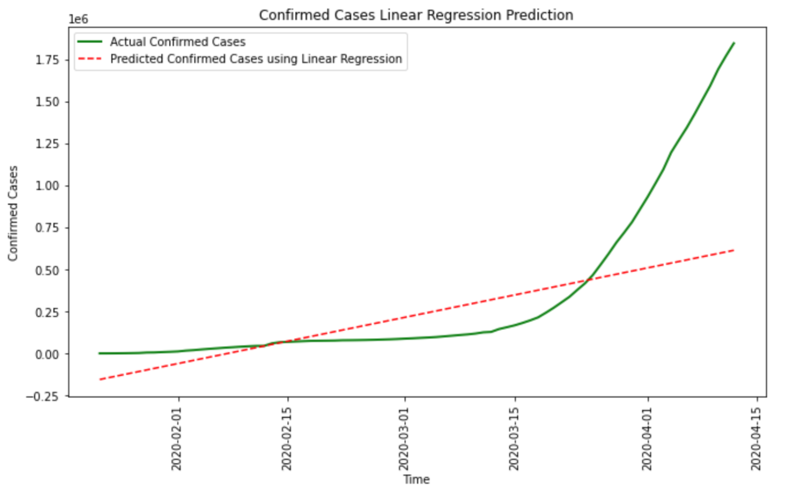
Linear Prediction Model - Confirmed Cases
The predictions of the Linear Regression model are completely off.
Root Mean Square Error for Linear Regression: 959965.38

Slide 20
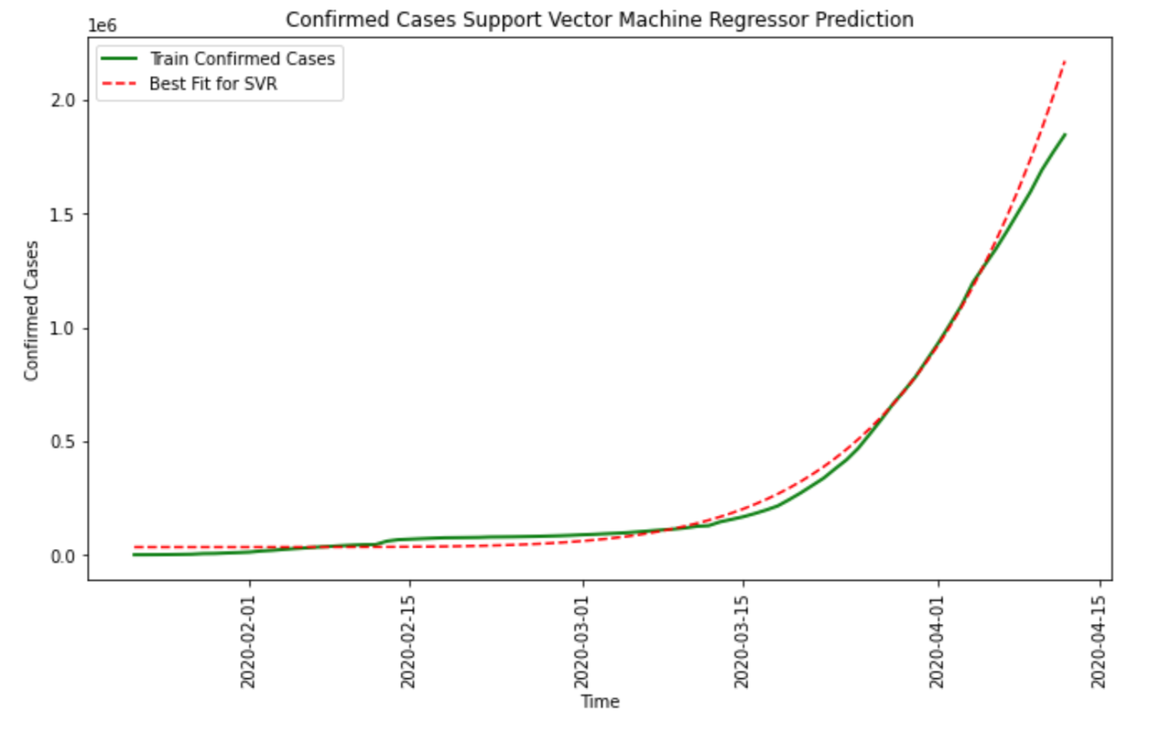
Support Vector Machine- Confirmed Cases
SVM handles non-linear data more efficiently and this is evident in the plot
Root Mean Square Error for Support Vector Machine: 161859.97552267514

Slide 21
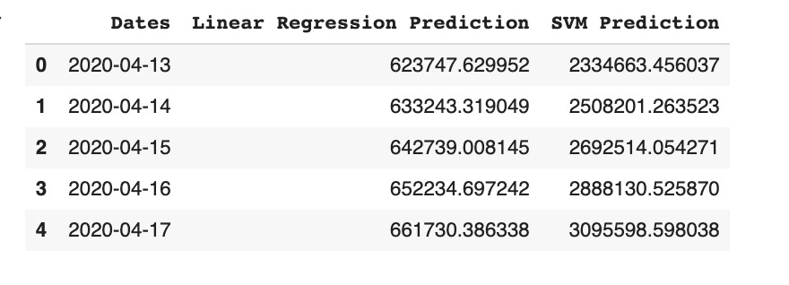
Table for comparison
Linear regression is good when the relation between covariates and the response variables is linear.
SVM on the other hand handles non-linear data efficiently. This is because it transforms non-linear data into linear data and then draws a hyperplane.

Slide 22
Thank You !

